Slide 1
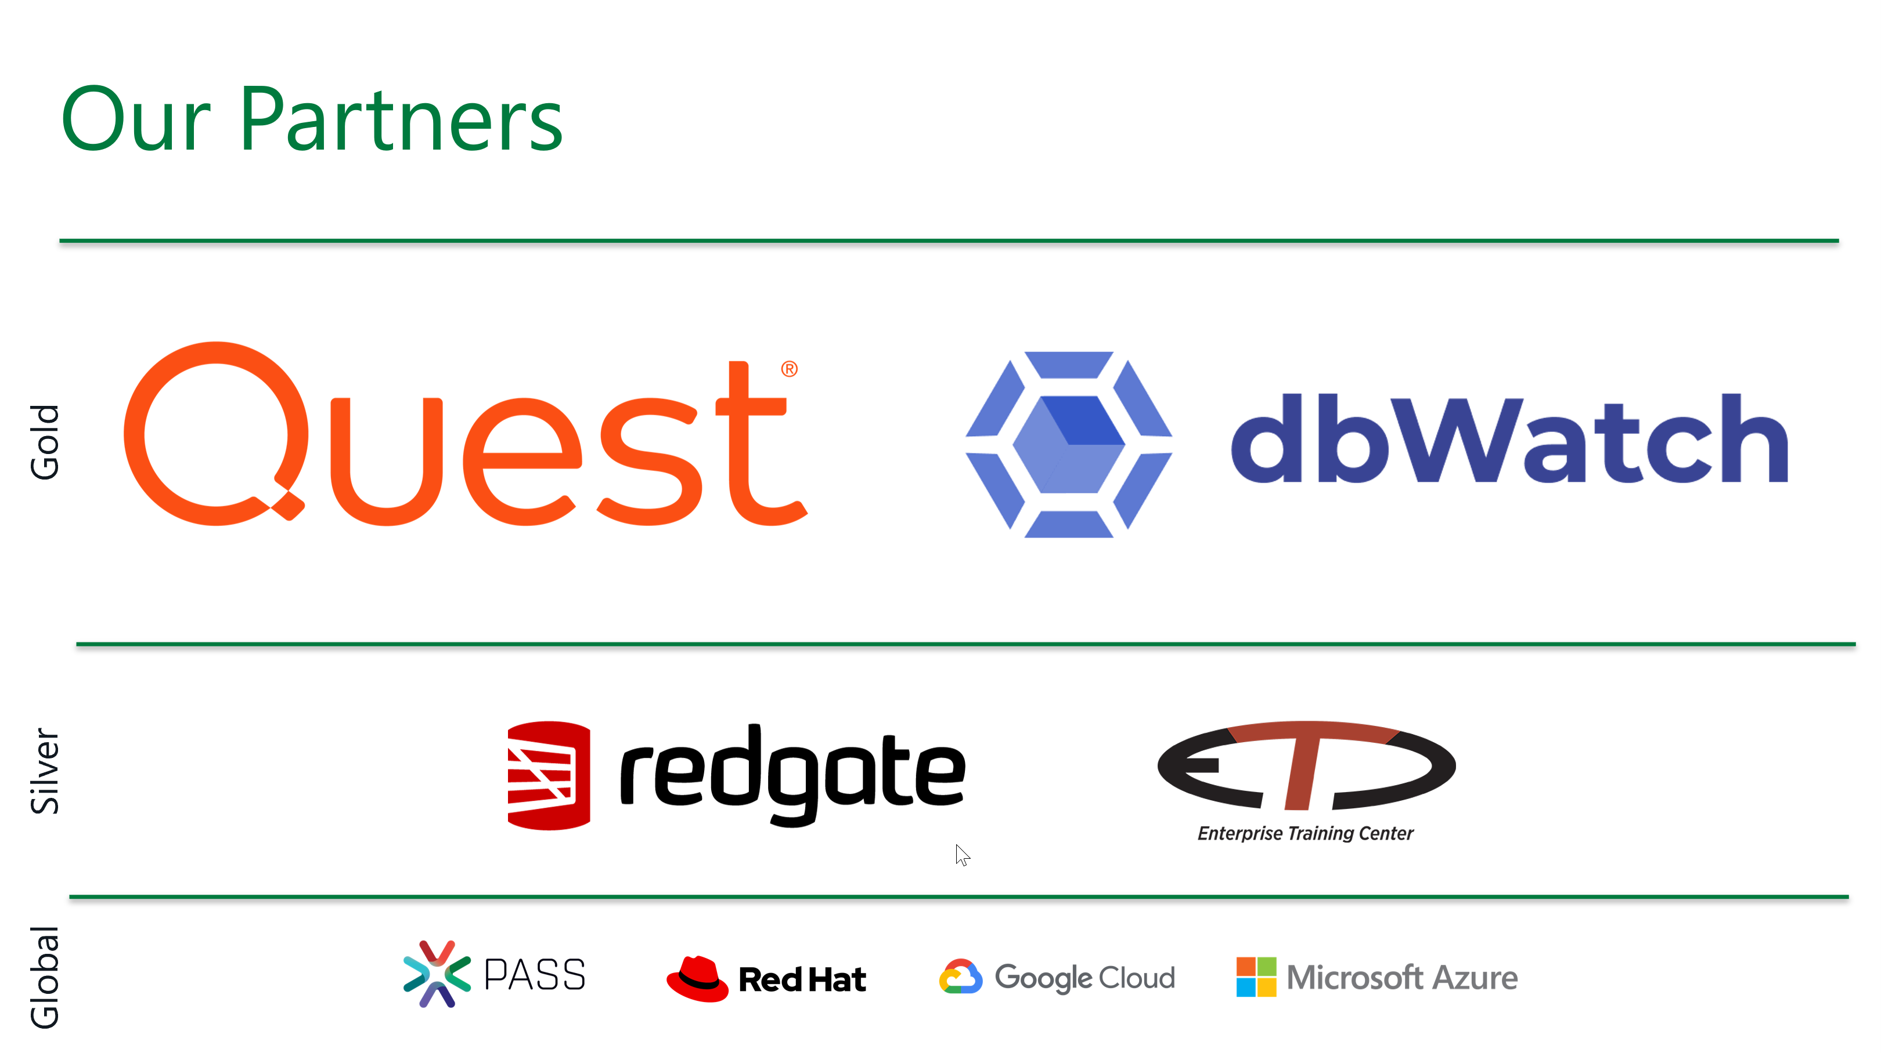

Slide 2



https://bit.ly/3bGN5PW
Humanitarian IT conference
Small Croatian towns of Petrinja, Sisak and Glina have been seriously hit with a massive earthquake on 29 December 2020.
Microsoft Most Valuable Professionals from all around Europe are organizing humanitarian IT conference to help the victims which lost their loved ones and their homes.
Join us in one of the kind conference with top MVP speakers in 4 tracks on Saturday, 16 January 2021 9AM to 5PM.
THANK YOU!

Slide 3



Notebooks 101 for SQL People
SQL Saturday #1015 Vienna Jan 15, 2021
Julie Koesmarno (@MsSQLGirl)
Program Manager, Microsoft
jukoesma@microsoft.com

Slide 4

Our learning journey today
1
2
Notebooks, eh?
Why Notebooks?
3
From SQL / PowerShell Scripts to Notebooks
🥡
Takeaways & Resources

Slide 5
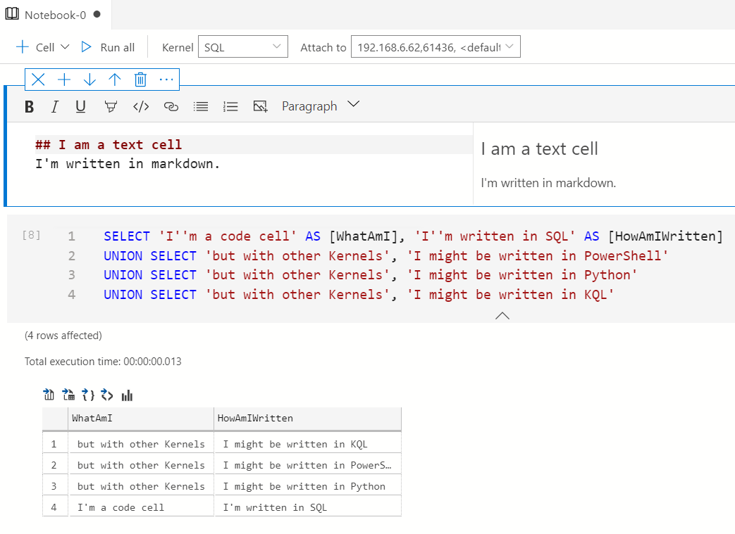
Notebooks
Text cells
Code cells
SQL
PowerShell
Python
KQL
.NET interactive
Notes:
Notebooks are made up of: text cells and code cells.
Notebooks are essentially just json file that gets rendered by a Jupyter Notebook viewer or Jupyter Notebook IDE like Azure Data Studio.
Kernel is essentially referring to languages that you can write code on the code cells. You can attach this to a specific compute location or data source.
When you save a notebook after execution, the result set will be saved also. It is important to clear results if you wish to remove things like sensitive data.

Slide 6

why notebooks?

Slide 7



--
-- Prepared by Cookie Monster
-- 2020.03.01
-- Question from Marketing about how much we sell and what's the shorter manufacturing time.
--
SELECT TOP 10 *
FROM Production.Product
ORDER BY Name ASC;
I need to know which product has the fastest turnaround ..
Let me query that!
Here you go…
Oh.. I need the product category..
-- Get Product list and product category with fast manufacture days
USE AdventureWorks2017;
GO
SELECT
c.Name AS ProductCategory
, p.Name as ProductName
, p.ProductNumber
, p.ListPrice AS Price
, p.DaysToManufacture
FROM Production.Product p
INNER JOIN Production.ProductSubcategory s
ON s.ProductSubcategoryID = p.ProductSubcategoryID
INNER JOIN Production.ProductCategory c
ON c.ProductCategoryID = s.ProductCategoryID
WHERE p.DaysToManufacture < 4
GO
-- Get Product List with fast manufacture days.
SELECT
p.Name as ProductName
, p.ProductNumber
, p.ListPrice AS Price
, p.DaysToManufacture
FROM Production.Product p
WHERE p.DaysToManufacture < 4
GO
Sure..
Here you go again…
1
Thanks! This is for the last quarter, right?
Do you mean sold products?
2

Slide 8

-- Get Product list and product category with fast manufacture days
USE AdventureWorks2017;
GO
SELECT
c.Name AS ProductCategory
, p.Name as ProductName
, p.ProductNumber
, p.ListPrice AS Price
, p.DaysToManufacture
FROM Production.Product p
INNER JOIN Production.ProductSubcategory s
ON s.ProductSubcategoryID = p.ProductSubcategoryID
INNER JOIN Production.ProductCategory c
ON c.ProductCategoryID = s.ProductCategoryID
WHERE p.DaysToManufacture < 4
AND EXISTS (SELECT TOP 1 1
FROM Sales.SalesOrderDetail sod
INNER JOIN Sales.SalesOrderHeader soh
ON soh.SalesOrderID = sod.SalesOrderID
WHERE sod.ProductID = p.ProductID
AND soh.OrderDate BETWEEN '20140101' AND '20140331')
GO
I need to know which product has the fastest turnaround ..
Let me query that!
Here you go…
3
Oh.. I need the product category..
Sure..
Here you go again…
Thanks! This is for the last quarter, right?
Do you mean sold products?
Here you go again…
You are a Rockstar! Thanks.

Slide 9
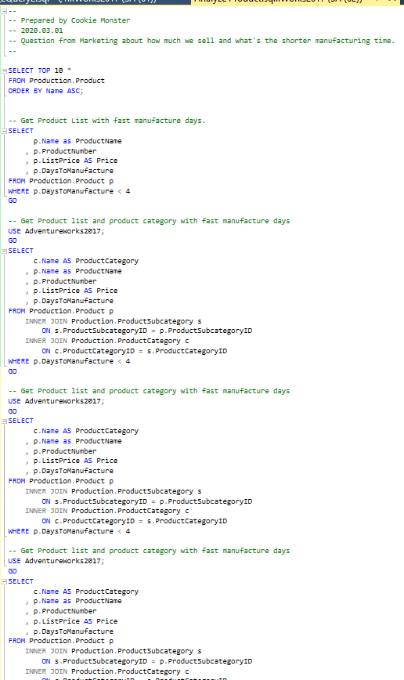
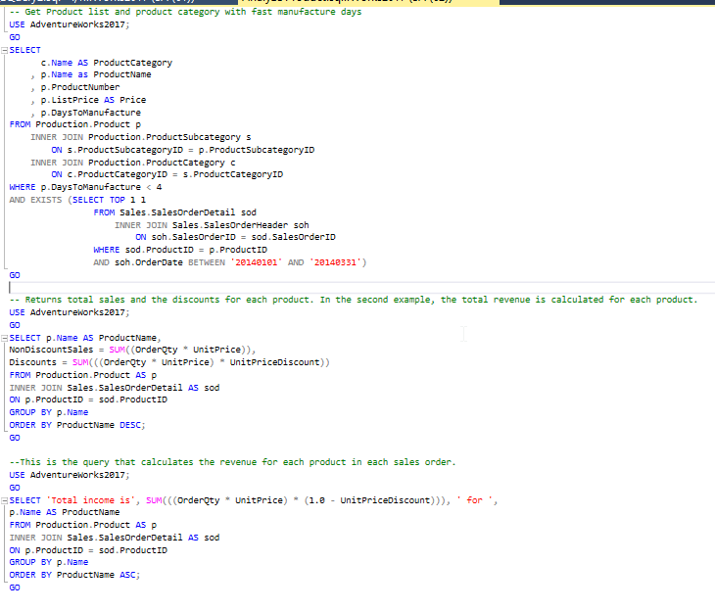
My dirty little scripts in the closet ….

Slide 10

Many days later …

Slide 11

You know that list that you sent me last time about that fast manufacturer… Can refresh it, please?
PANIC
PANIC
PANIC
What list?
PANIC
Oh.. That list! Yea yea…
Here you go again…
PANIC
I want to compare what the result back then and what it is now; if we have had any changes…
PANIC
PANIC
Was the logic the same as what you did last time?
PANIC
Hello?
PANIC

Slide 12

Jenga
what’s the problem?
with your SQL scripts?

Slide 13

What’s the problem?
When scripts and output are separated …
Hard to reproduce based on output (reproducibility)
Code looks good, but is it returning the right results? (code review)
I executed this script so I guessed it worked last time? (auditing)
What is this script about? (context)
For Troubleshooting guide, lots of copying and pasting code (executable)

Slide 14

Documentation
Executable
notebooks
Code
Results
Visualization
Analysis & Interpretation

Slide 15
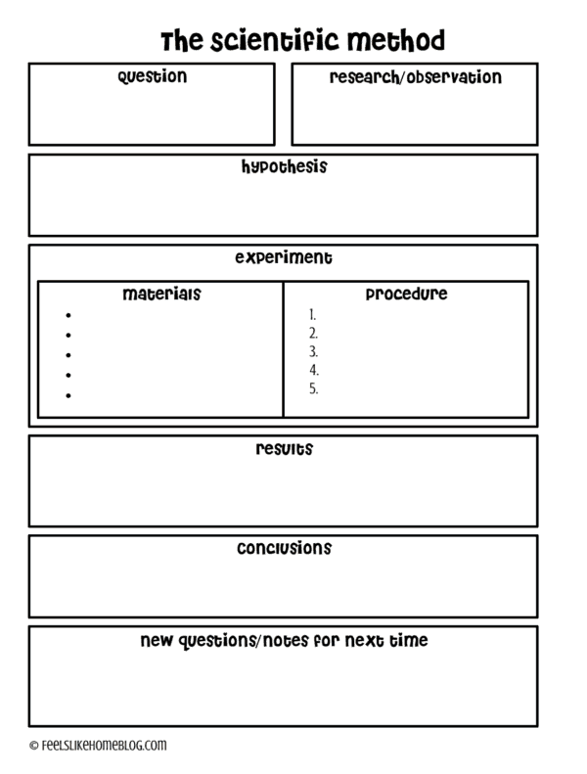

What is Reproducible Analysis?
remember School Science Projects?
Source: https://feelslikehomeblog.com/2017/07/the-science-of-slime-its-way-more-than-polymers/

Slide 16


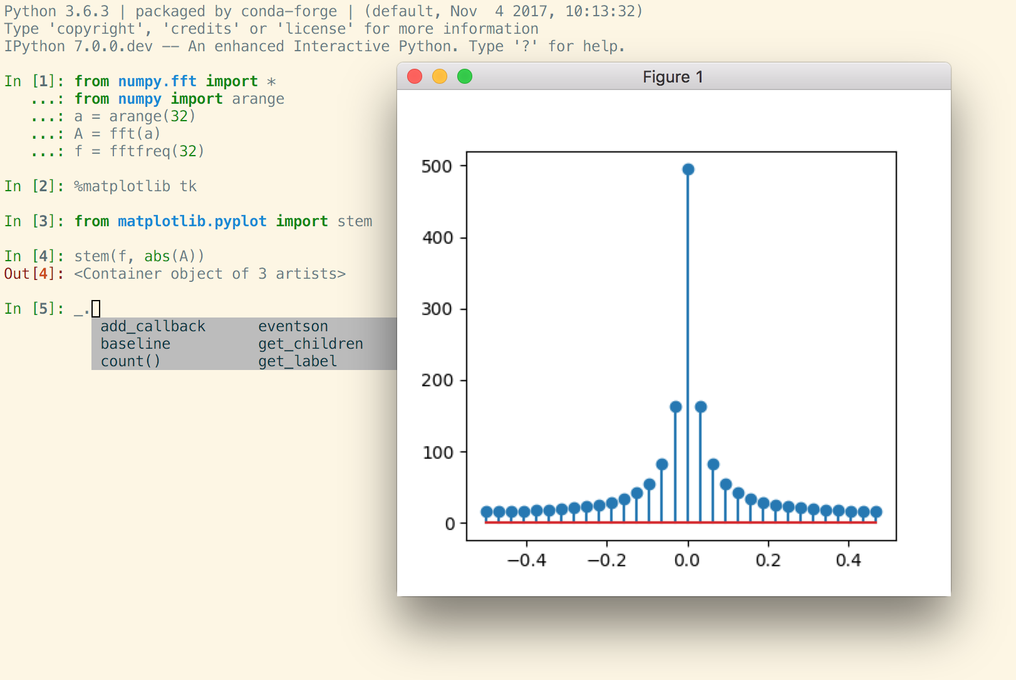



Mostly for Data Science projects
Open Source, open-standards and services for interactive computing for multiple languages – formed in 2015
Command shell for interactive computing – since 2001
Azure Databricks
Azure Synapse
VSCode
+ other viewers
Azure Data Studio introduced notebooks in 2018 for Data professionals; and specifically for SQL People since 2019
Notebooks Journey

Slide 17

notebooks in
azure data studio

Slide 18
Notebook Use Cases
Notebook as UX
Deployment
Troubleshooting
Notebooks as Documentation
Documentation
Education, Blogging
Feature Discovery
Notebooks for Data Workflows
ML Notebooks
Data Science
Data Engineering
Operational Notebooks
Execute as Job, Testing
Command Line Execution
Incident Response Workflow
Notebooks for Collaboration
Collaboration
Reporting
Data Viz
Notes:
These are what we (SQL Tools & Experiences team) are envisioning Notebooks.

Slide 19

Jump start with your existing scripts
SQL scripts to Notebook: ConvertTo-SqlNotebook
Powershell scripts to Notebook: ConvertTo-PowerShellNoteBook
https://github.com/dfinke/PowerShellNotebook
Notes:
Demo:
Convert SQL to notebooks, Convert PowerShell to Notebooks
Packaging Jupyter Book to Git.
Opening Jupyter Book in ADS.
Packaging notebooks as an extension or a remote book -> Only show an example on what the shipped version looks like.

Slide 20
Notebook Development and Sharing
Write Notebooks in Azure Data Studio
Troubleshooting Guide template
Bundle and organize your notebooks as Jupyter Books
Use source control – e.g. GitHub, Azure DevOps
Ship it!
For external facing use GitHub release features, example: https://github.com/MsSQLGirl/jubilant-data-wizards/releases/tag/v0.0.0
Ship as an Azure Data Studio extension to launch a Jupyter Book
Integrate with your incident response system
Ensure troubleshooting notebooks are evaluated and fixed during post-mortem
Watch for novel incidents with missing notebooks
New features should be accompanied with troubleshooting notebooks

Slide 21






Incident Response Flow & Ecosystem
System Event / User Reported Incident
Use existing notebooks
Create new notebooks
Add reusable notebook
Rate existing notebooks
Log adhoc notebook in incident system
Update notebook if necessary
Automate
Incident Response System
Investigate & Mitigate
Use Notebook as the incident’s audit trail
Post Mortem
Analyze and enrich Troubleshooting Repo
Troubleshooting Notebook Repo
Notes:
JULIE

Slide 22

learn more …

Slide 23

Useful resources
http://aka.ms/AzureDataStudio | Sample files: https://bit.ly/2YGTpAy https://github.com/microsoft/azuredatastudio/issues
Tiger Toolbox:
SQL Assessment Toolkit: https://github.com/microsoft/sql-server-samples/tree/master/samples/manage/sql-assessment-api/notebooks
SQL Hybrid Toolkit: https://github.com/microsoft/tigertoolbox/tree/master/SQL-Hybrid-Cloud-Toolkit/content
Glenn Berry’s Diagnostic Notebooks for SQL Server and Azure SQL DB:
https://glennsqlperformance.com/resources/
Rob Sewell’s Notebook http://sqldbawithabeard.com https://github.com/SQLDBAWithABeard/JupyterNotebooks
The SQL Diagnostic (Jupyter) Book by Emanuele Meazzo https://tsql.tech/the-sql-diagnostic-jupyter-book/

Slide 24
Key take-aways
Notebooks for SQL people use cases
Reproducible research, aka. Data analysis and data exploration.
Troubleshooting guides for incident response
Tutorial / How-to’s
Data Engineering
Deployment
Language (Kernel) supported in Azure Data Studio:
SQL
PowerShell
Python
PySpark
Spark Scala
Spark R
.net interactive
Try it out today: http://aka.ms/getAzureDataStudio

Slide 25

give it a go!

Slide 26
thank you!
Julie Koesmarno (@MsSQLGirl)
Program Manager, Microsoft
jukoesma@microsoft.com

